Slide 1
Git, GitHub, & Version Control
By: David Guetzlaff

Slide 2
Overview
Version Control
Git
GitHub
- I’ll try to stop and answer questions

Slide 3
What is Version Control?
Keep track of changes on a group of files
Ability to go back to a previous point in the project

Slide 4
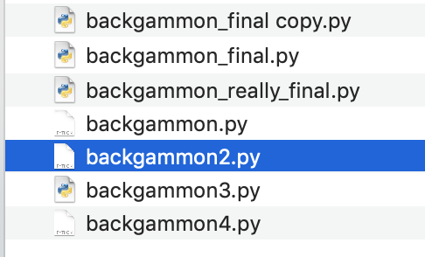
Why We Want This
Don’t need multiple copies of files
If you make a mistake, you can undo easily

Slide 5
Version Control Software
Mercurial
Apache Subversion
Git

Slide 6
What is Git?
Developed by Linus Torvalds
Git is an opensource distributed version control system
Interact through the command line/terminal

Slide 7
How To Use Git

Slide 8
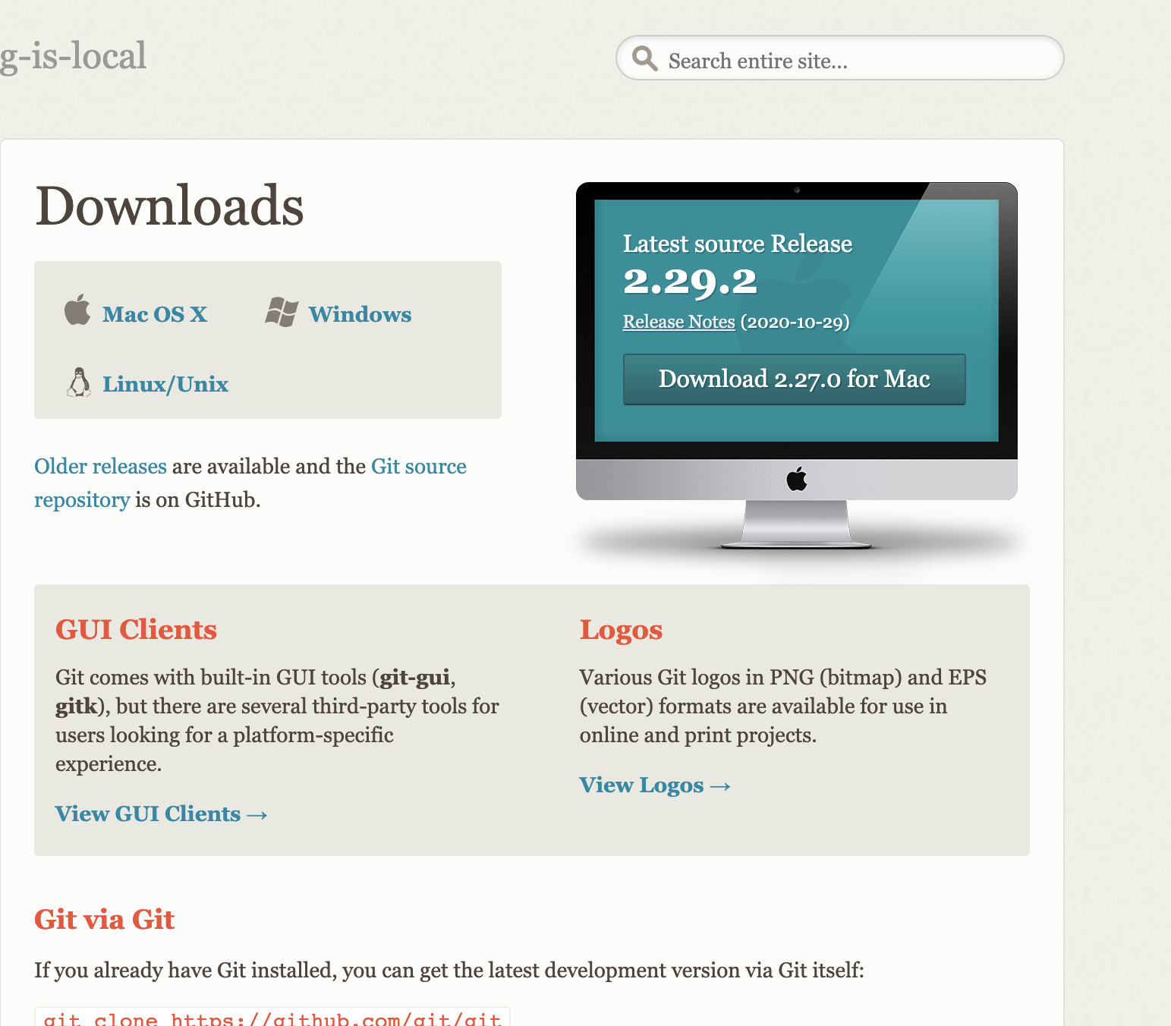
Download Git
https://git-scm.com/downloads

Slide 9
Git Repository (or Repo)
Where all the files relevant to the project are stored
For us this includes…
Source Code, Test Code, Build Files/Scripts

Slide 10
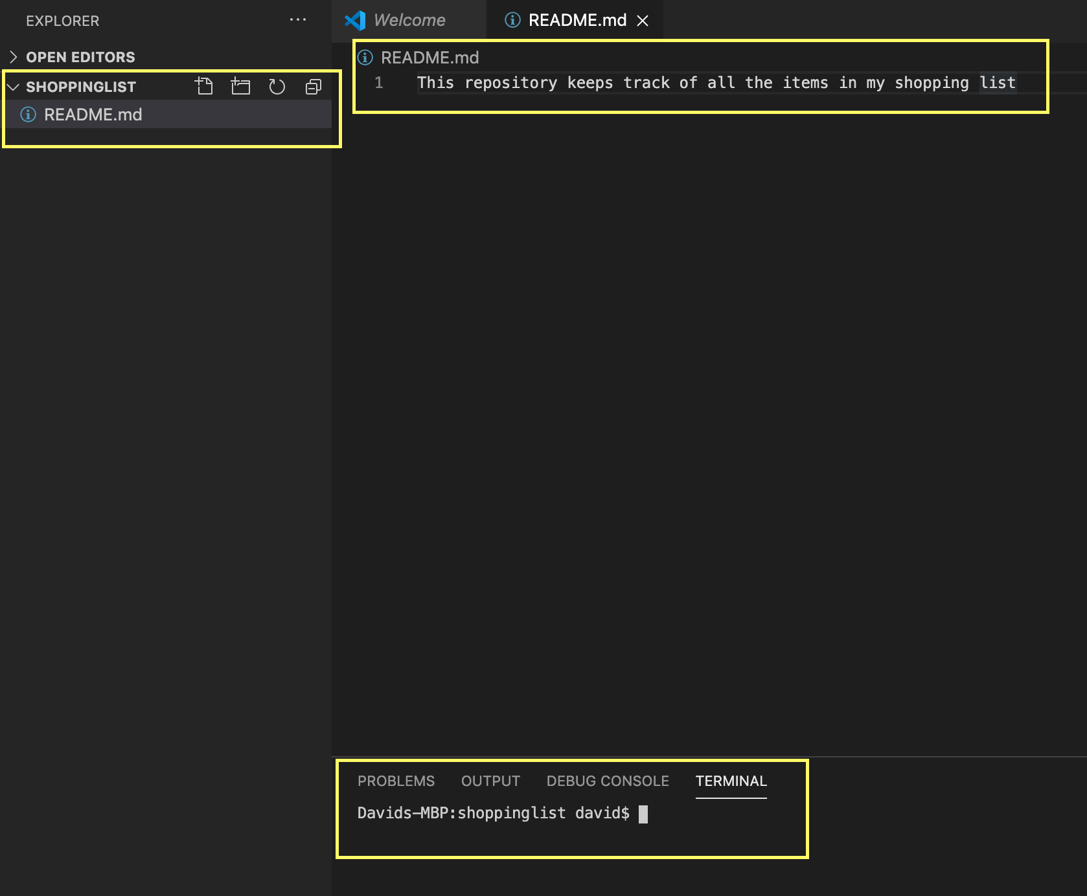
Creating A Git Repo
1. Create a folder with a file in it

Slide 11
Creating A Git Repo
2. Run git init in the terminal window

Slide 12
Making our First Commit
Check the status of files with git status

Slide 13
Git Workflow
Working
Staging Index
Repository
git add
git commit

Slide 14
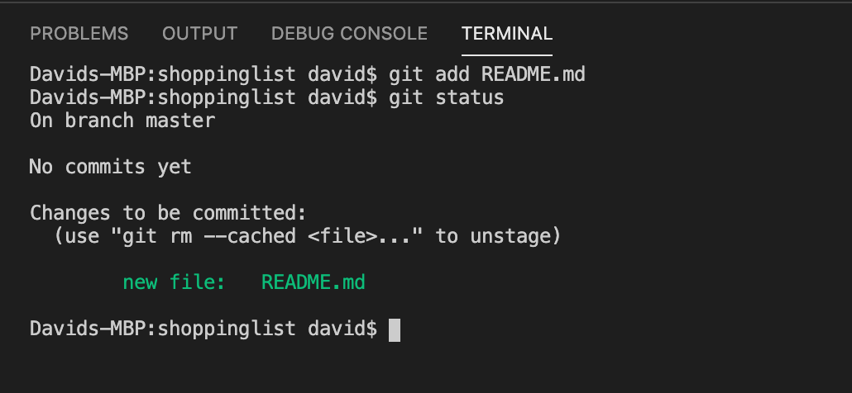
Adding to Track Files
Add changes into the staging index (git add)

Slide 15
Committing Files
Most important git command is git commit
Can be thought of as the same thing saving

Slide 16
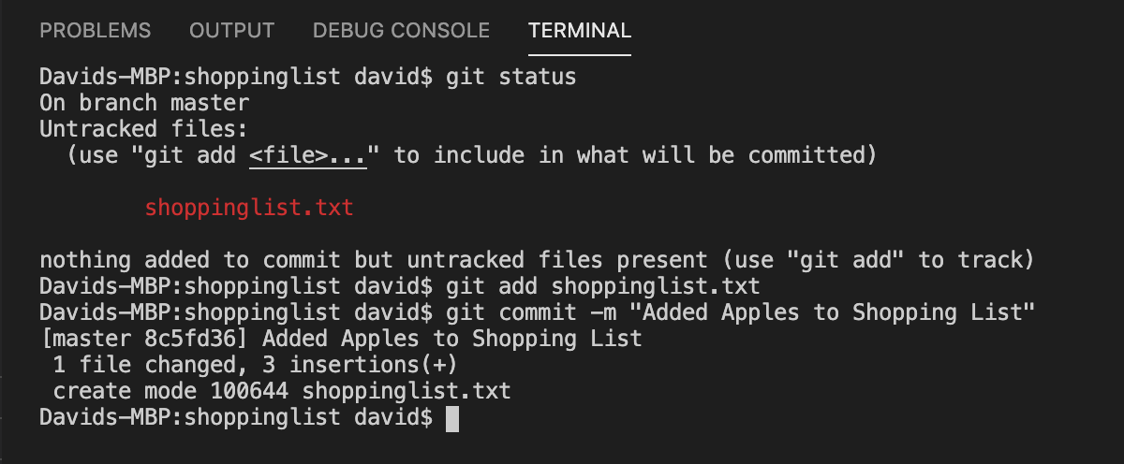
Start Working
Created a new text file
Now it is time to save the file

Slide 17
Commit Message
A commit message is denoted with –m flag
Ex. git commit –m “Added apples to shopping list”
Important that they are short and descriptive
Don’t commit too much at once
Changes in a commit should relate

Slide 18
Git Workflow
Edit a file
Working
Staging Index
Repository
git add
git commit

Slide 19
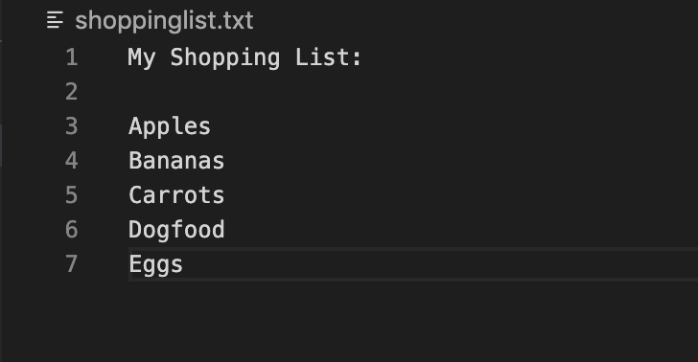
Shopping List Continued
Added more items to the list
How did we get to this point?

Slide 20
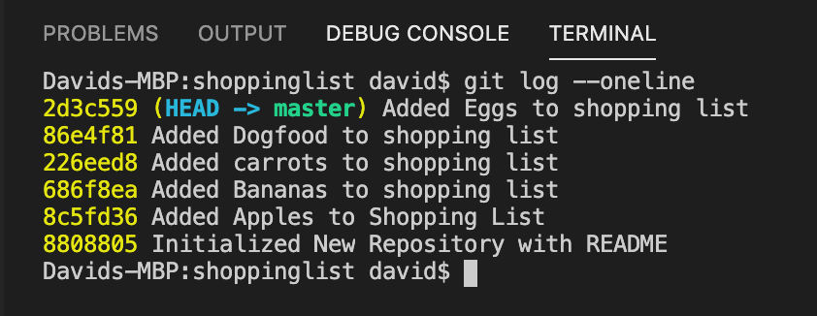
Looking at Change History
View the commit history with git log
--oneline shows hash message only
Commit hash

Slide 21
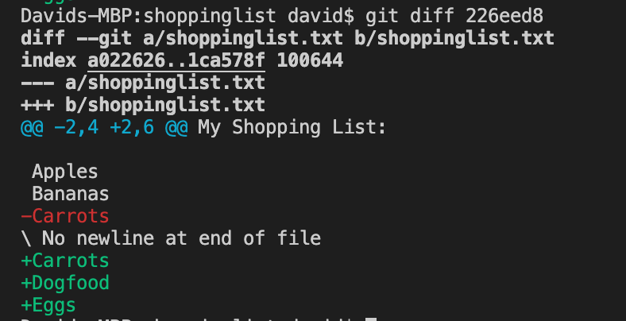
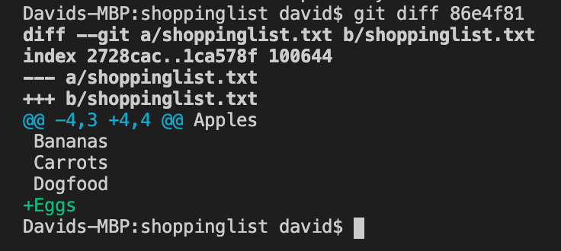
Looking at Changes
Look at changes with git diff

Slide 22
Branching in Git
git checkout commit_hash –b new_branch
new branch
master branch

Slide 23
Merging in Git
git merge branch_name
new branch
master branch

Slide 24
Branching Concepts Git
feature branch
defect fix
master branch

Slide 25
Removing Files
Remove files from a repo with git rm file_name
Git removes need to be committed like any other change

Slide 26
About GitHub

Slide 27
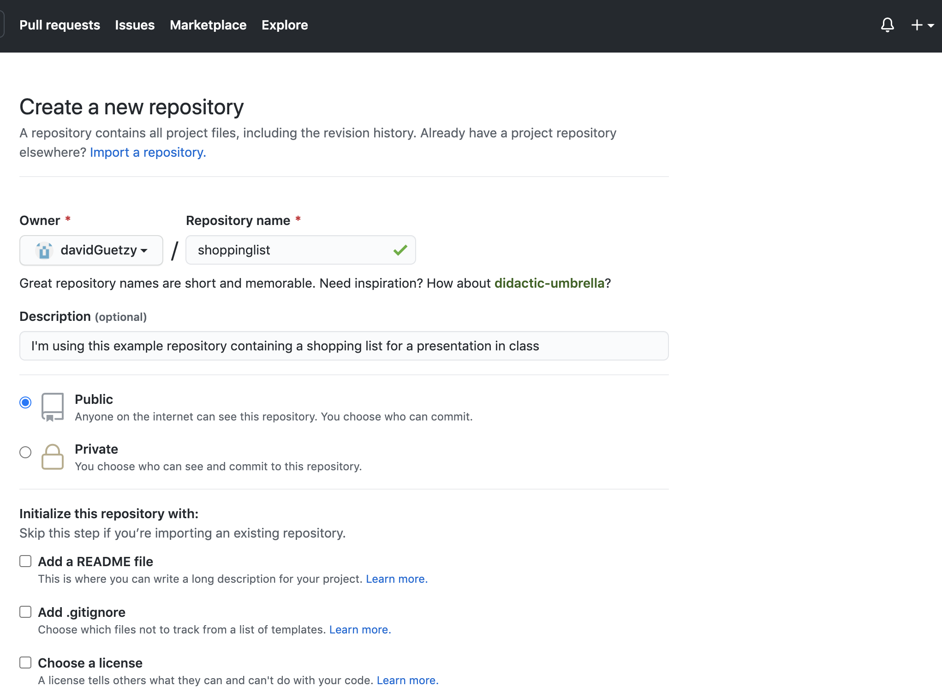
GitHub
Webservice – do Git things online
Connect your local repo to a remote
git remote add origin repo_url

Slide 28
More About GitHub
Promotes Collaboration
Store stuff out on the web, see history
Can even interact with other people’s work
3 main commands for this

Slide 29
Working with Remote Repos
git clone repo_url – Gets you that entire repo’s history and contents
git push – send a set of commits up to the remote repo
git pull – grab the latest changes from remote repo
Others have made changes

Slide 30
Git Workflow
Remote Repository
push
pull
Local Repository
Local Repository
Local Repository
Staging Index
Staging Index
Staging Index
Working Directory
Working Directory
Working Directory
Alice
Brad
Charlie

Slide 31
My CS225 Repository
https://github.com/davidGuetzy
- Commit from November 12 on paystation branch

Slide 32
Should You Use Git/GitHub?
Yes!!
There is some overhead in learning/using
Makes collaboration and history review easy
Also have GUI’s for Git to avoid the command line
GitKraken, SmartGit

Slide 33
Resources to Learn More
Youtube – search for Git tutorials
freecodecamp, the coding train
Git Website - https://git-scm.com/doc
GitHub Guides - https://guides.github.com/
Understanding the GitHub Workflow, Hello World

Slide 34
Image Credits
https://www.google.com/url?sa=i&url=https%3A%2F%2Fwww.g2.com%2Fproducts%2Fmercurial%2Freviews&psig=AOvVaw10yAryCoc_Tu-RFfDNPeRT&ust=1605722613430000&source=images&cd=vfe&ved=0CAIQjRxqFwoTCOiNvI2Viu0CFQAAAAAdAAAAABAE
https://www.google.com/imgres?imgurl=https%3A%2F%2Fupload.wikimedia.org%2Fwikipedia%2Fen%2Fthumb%2F9%2F9f%2FSubversion_Logo.svg%2F1200px-Subversion_Logo.svg.png&imgrefurl=https%3A%2F%2Fen.wikipedia.org%2Fwiki%2FApache_Subversion&tbnid=BP8aARxaRDRHkM&vet=12ahUKEwj4jPCulYrtAhULU80KHbn8DQoQMygAegUIARCjAQ..i&docid=25_yZVBUVWktxM&w=1200&h=718&q=apache%20subversion%20software&ved=2ahUKEwj4jPCulYrtAhULU80KHbn8DQoQMygAegUIARCjAQ
https://www.google.com/imgres?imgurl=https%3A%2F%2Fe7.pngegg.com%2Fpngimages%2F713%2F558%2Fpng-clipart-computer-icons-pro-git-github-logo-text-logo-thumbnail.png&imgrefurl=https%3A%2F%2Fwww.pngegg.com%2Fen%2Fpng-etzdt&tbnid=WQFF_mJvulvFyM&vet=12ahUKEwiYjbnQlYrtAhUPXs0KHfegAvYQMygGegUIARDEAQ..i&docid=clEn0UzmXsFGpM&w=348&h=348&q=git%20logo&ved=2ahUKEwiYjbnQlYrtAhUPXs0KHfegAvYQMygGegUIARDEAQ
https://www.google.com/imgres?imgurl=https%3A%2F%2Fupload.wikimedia.org%2Fwikipedia%2Fcommons%2F0%2F01%2FLinuxCon_Europe_Linus_Torvalds_03_%2528cropped%2529.jpg&imgrefurl=https%3A%2F%2Fen.wikipedia.org%2Fwiki%2FLinus_Torvalds&tbnid=Qycm8FlFHDchpM&vet=12ahUKEwjDia7plYrtAhUOIM0KHfhCDxkQMygAegUIARDGAQ..i&docid=mVCx5kujdY4XmM&w=975&h=1357&q=linus%20torvalds&ved=2ahUKEwjDia7plYrtAhUOIM0KHfhCDxkQMygAegUIARDGAQ

